Slide 1
REALIZING UB 2020
Remarks to the Voting Faculty
February 5, 2013
Notes:
Welcome and introductory remarks:
Pleased to have this opportunity to talk with the Voting Faculty about where we are with UB 2020 and our vision for taking it to the next level.
The objectives we’re pursuing as we realize the UB 2020 vision are closely aligned with the national conversation about higher education today. I also wanted to take this opportunity to provide you with my sense of the major issues and challenges facing higher ed at a national and global level (e.g. affordability, access, new modes of educational delivery) and how we are working to respond to those issues here at UB.
This a balancing act: Higher ed is struggling with various tensions between growing demands on our nation’s universities and the need to stay true to our academic mission and our commitment to excellence:
How should research universities like UB respond to political demands on higher education, including growing expectations for economic impact?
What are our responsibilities beyond our immediate student community? Beyond our core educational and research mission, how much are we doing—and should we be doing—to ensure an educated citizenry for the 21st century global world (e.g. addressing broad social needs for education in literacy, global competence, basic research)?
Should universities do more to defend and explain our societal relevance and critical value in contributing to the public good? What is the role for our faculty in this regard?

Slide 2
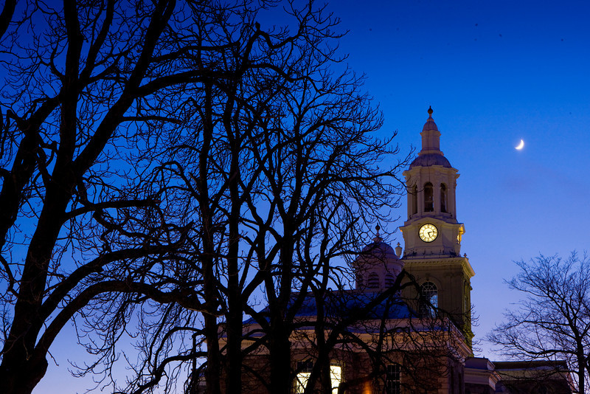
UB’s Vision: Distinctive, renowned, impactful
Notes:
Framing the moment:
While UB is struggling with the same issues as our peers across the nation, we also have tremendous opportunities in front of us right now:
Academic mission is moving forward in the right direction
5-year period of budget stability helps us plan with confidence
A very strong physical environment
All of this provides us with a window of opportunity for advancing our vision of excellence: UB 2020. We aim to be recognized as one of the best research universities in the nation and world:
We want the world to know about UB as a top destination for innovative research and discovery.
We want UB to be a place where bright students flock because they know they will have the opportunity to work directly with faculty at the cutting-edge of their fields.
We want to make UB a creative mecca and an established leader in health sciences education, research, and clinical care.
We are already on our way. For example, we were recently named in the top 200 universities worldwide—in the company of the world’s best research universities like Oxford, Cambridge, and Tokyo University.

Slide 3
Realizing UB 202o:
Key Principles
Distinctiveness
Relevance
Leadership
Notes:
Many of you joined me in November for my first State of the University address, where I challenged us to move forward with the next evolution of our vision—Realizing UB 2020—and charged Provost Zukoski with leading the campus dialogue about this process. I know many of you have been contributing to the Open Forums, and I thank you for your valuable insights and leadership.
This next phase is about harnessing all of the progress and momentum that has been steadily building throughout the UB 2020 process.
It’s about defining what truly sets us apart as a world-class research university—our distinctive opportunities for leadership and impact.
It’s about working together across the university to position ourselves to make the most of these strengths.
It’s about organizing ourselves to enhance our relevance in responding to broadly defined social challenges (e.g. health, the environment, creativity, justice)
In pursuing this effort, we also establish UB as a leader in addressing the very issues that our nation’s higher ed institutions are confronting, including:
College affordability and student debt
How to ensure our students get the timely, relevant education they need to compete successfully in a crowded global marketplace
How to meet growing demands for access and changing student demographics (e.g. should UB explore MOOCs, and if so, what does this entail in infrastructure and assessment of student learning?)
Growing expectations for economic impact, and how to meet these demands without compromising our academic mission.

Slide 4
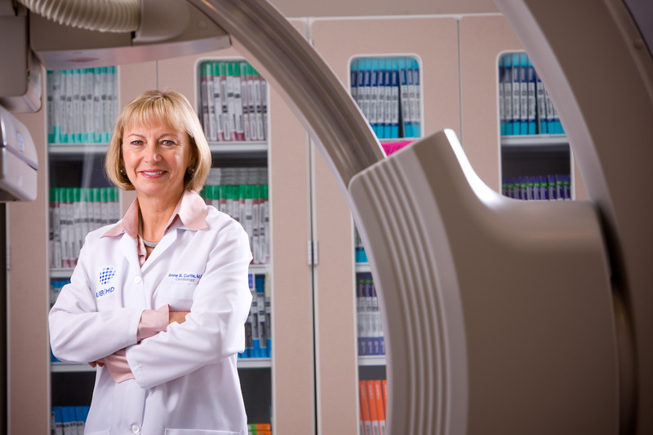
Notes:
These kinds of broad, high-level questions are not new for us at UB—they have been key considerations for us throughout the UB 2020 process.
Our best response is through the work we do as an academic institution. Through UB 2020, we are meeting these challenges by pursuing 3 key objectives —all closely connected and carried out across all 3 campuses.
Bringing more of the world’s best faculty to UB—across the disciplines—and harnessing the impact of their research and discovery
Creating the transformative environment that prepares our students to be 21st century leaders—here in WNY and in the global community
Providing the infrastructure and physical campus climate that enable our faculty, staff, and students to thrive across all three campuses.
Achieving this vision is a collective effort, drawing on the collaborative work of our entire UB community. The leadership and contributions of the faculty are instrumental to all we’ve already achieved, and will be critical to our continued success. Your work drives the academic mission, and sets in motion every element of the university enterprise—from the students we educate to the way we share our research for the benefit of the communities we serve.
Realizing UB 2020, the next phase of our strategic vision, builds on the momentum we have already achieved through UB 2020, and uses it as the springboard for taking our excellence and our impact to the next level.

Slide 5
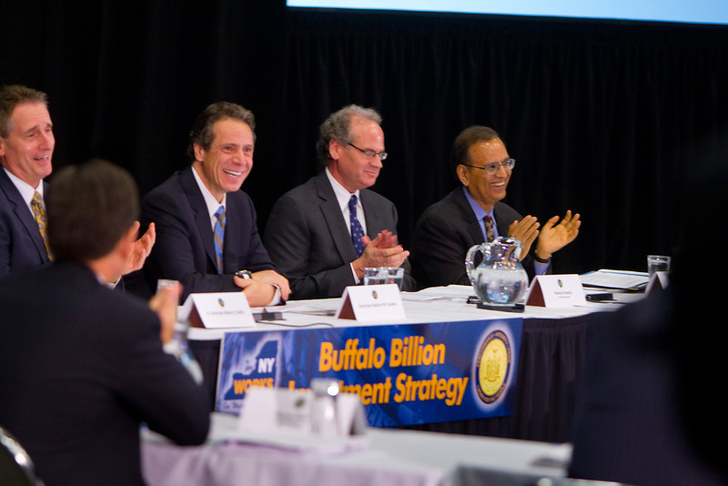
Notes:
While we certainly face the same challenges our peer institutions do in a climate of economic uncertainty, this is also a critical moment of opportunity for UB.
Our progress as a university is taking place in the broader context of a time of significant momentum for our region. UB is—and should be—a key part of that momentum.
Regional Economic Development Council
Buffalo Billion
NYSUNY 2020: Five years of financial stability is game-changing for UB, allowing us to plan with confidence.
UB is committed to delivering substantial returns on investments made to our university. We are already well on our way.
We are deeply engaged in the well-being of our larger communities. This is not just a matter of fulfilling our commitment to the state. It is vital to who we are as a public research university. We are not an ivory tower—we are part of the fabric of our community, and we have an ethical responsibility to play a leadership role in the social, economic, and cultural vitality of our region.

Slide 6
Realizing UB 202o:
Investing in Our Faculty:
Growing our faculty across the disciplines
+ 250 over 5 years
Growing research expenditures
+ 40% over 5 years
Notes:
With the support and contributions of the entire university community, we are establishing UB as a leader every day. We are an incredibly complex organization, but all of our work begins with the work of our faculty:
Delivering an outstanding education to our undergraduate, graduate, and professional students
Advancing UB’s excellence in terms of basic, applied, and translational research
Translating your pioneering research to the marketplace through discoveries and inventions that improve the quality of life locally as well as globally
Helping UB build healthier communities, sharing our arts, educational, and cultural expertise; and providing outstanding clinical care
To continue on our trajectory of excellence, it’s imperative that we build faculty strength in key areas.
Our 5-year faculty investment goals include:
Grow tenured/tenure track faculty by 250
Grow Research Expenditures by $60 M (40%)

Slide 7
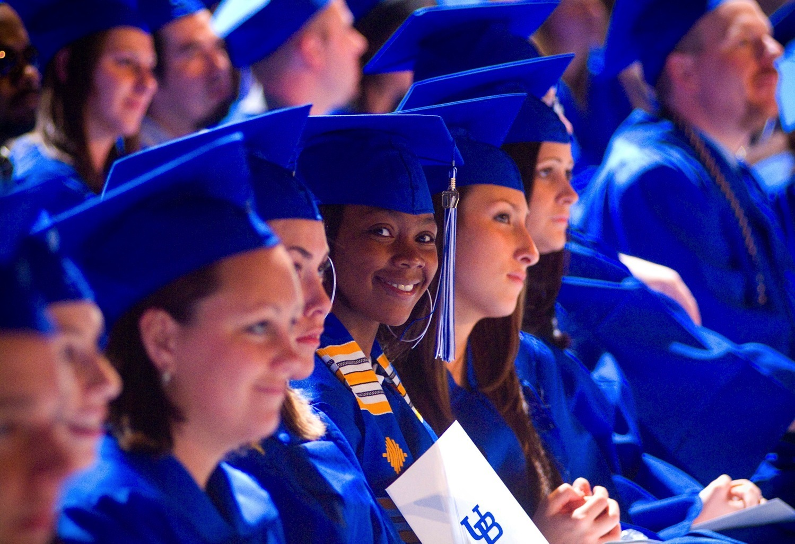
Notes:
UB is playing a leadership role in proactively responding to nationwide challenges in higher education. Providing a timely, relevant curriculum that prepares students for success is a key priority for the higher ed community nationwide. Providing our students with a world-class education is at the heart of our mission. For UB, this means preparing our current and future students to be global leaders in the 21st century.
Faculty play the critical role in this mission. Our faculty drive the curriculum and bring that curriculum to life with cutting-edge research experience, community engagement opportunities at home and abroad.
Many of you work directly with students in the Honors College and Undergraduate Academies, including UB’s newest academies in Entrepreneurship (launched Fall 2012) and in Sustainability (launching Fall 2013).
Our students already participate in study abroad at over 5 times the nationwide rate. We want to create even more opportunities for our students to gain global experience, and we are looking at innovative ways to bring these experiences into the curriculum.
For example, you may have helped advise those planning the new inter-session initiative that will allow for a wide array of new opportunities for our students, such as an intensive winter seminars overseas (e.g. Ezra Zubrow’s anthropology seminar in Siberia).
Our focus is on creating transformative opportunities for our students at every level—undergraduate as well as graduate and professional.
For example, Law School clinics in affordable housing, elder care, and environmental policy.

Slide 8
Investing in Our Students:
40% of entering class in Finish in Four
300 new course sections this fall
12,000 new students accommodated
Notes:
As a critical part of our mission, we are committed to ensuring that a world-class UB education is an opportunity available to all with the talent and motivation to pursue it. This element of our mission has never been more important in the current climate for higher ed in the 21st century, where student debt, college affordability, and access to educational opportunity are steadily escalating national issues.
NYSUNY 2020 revenues have enabled us to make critical investments in academic support for our students, including the Finish in Four program, which aims to ensure that all of our students have the resources and support they need to graduate in four years.
Many of the faculty in this room played an integral role in the successful launch of this program—a collaboration across many units.
And many of you are seeing a direct impact in your classrooms. While Finish in Four is focused on providing more course sections and accommodating more students, we also are committed to ensuring to keeping faculty-student ratios reasonable, so our students get the close interaction they need and so that you as faculty have the classroom environment you need to teach effectively.
Our 5 year goals also include raising more funds for student scholarships to help bring more of the best and brightest students to UB and help make a UB education more accessible and affordable.

Slide 9
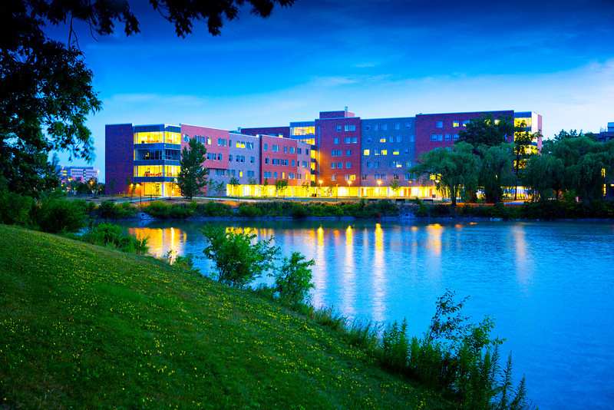
Creating the physical climate
Notes:
We compete on a national and global level for the best and brightest students and faculty. To attract them, and to provide them with the transformative opportunities they need to excel once they are here, we must have the right physical campus climate in place. Every element of our UB 2020 vision—cutting-edge research and discovery, world-class clinical care, an innovative 21st century curriculum, enhanced student learning—hinges on the physical environment we are able to provide.
With that in mind, UB has undertaken major building renovations and new buildings across our 3 campuses.
These capital projects are essential:
To compete nationally and internationally for the best faculty and best students
To provide our students with a world-class education
And to attract precious federal research funds.

Slide 10
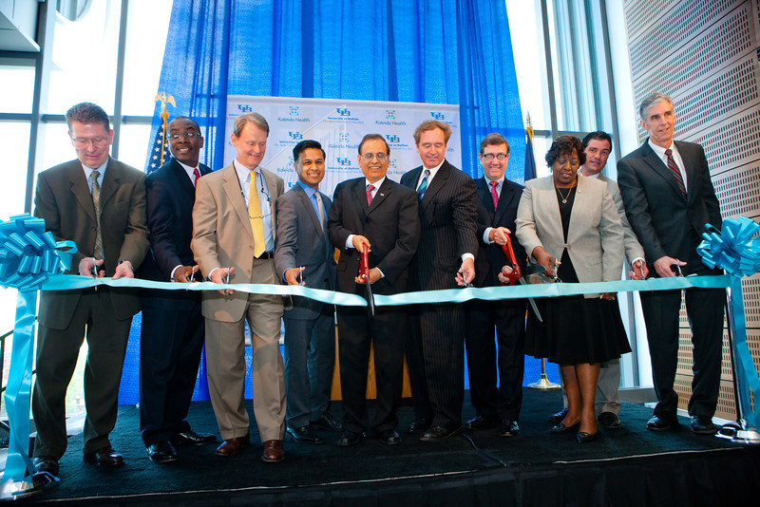
Notes:
Notes and for your reference:
Building the climate for excellence—all in a little over a year
Greiner Hall
Solar Strand
Davis Hall
Clinical and Translational Research Center
Kapoor Hall
Culinary Crossroads Center (Re-opening of revitalized Red Jacket dining hall)
Forthcoming: Educational Opportunity Center: Spring 2013

Slide 11
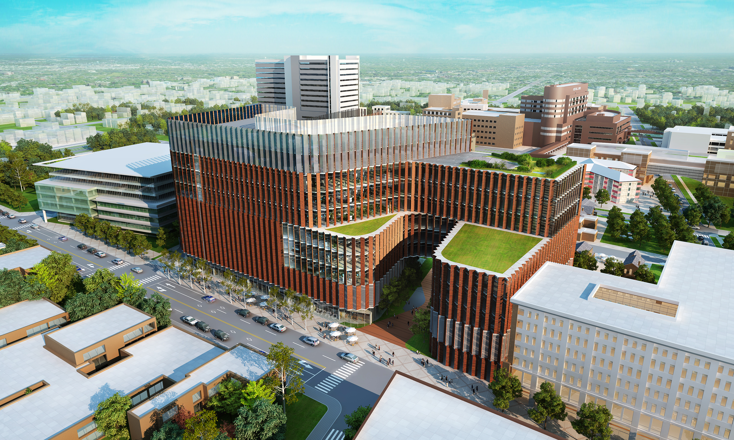
Notes:
UB is earning national attention for the model provided by our medical school relocation downtown. I know that many of you are especially interested in the progress of this effort, which will have a tremendous impact not only on those of you engaged in the health sciences schools, but across the university. We are making exciting progress:
Engaged HOK, an internationally renowned architectural firm; working together to finalize an innovative design for the building (NOTE: the image on the slide is only a preliminary concept, not the actual design).
Steadily moving forward with land acquisition for the downtown site
On track to break ground in September 2013.
A world-class integrated academic medical center downtown, located in close proximity to our city’s hospitals and health care partners, will:
Enhance clinical education and training opportunities for our students by fully leveraging the vast health care resources the city provides
Greatly improve the quality of healthcare for our community
Leverage existing synergies and state investment in downtown hospitals and research institutions and develop new health care partnerships
Act as a catalyst for commercialization and technology transfer, substantially growing high-tech business and industry in the area.
Establish UB and Buffalo as a renowned destination for state-of-the-art health care, and eliminate the need for Western New Yorkers to seek specialized medical care out of town

Slide 12
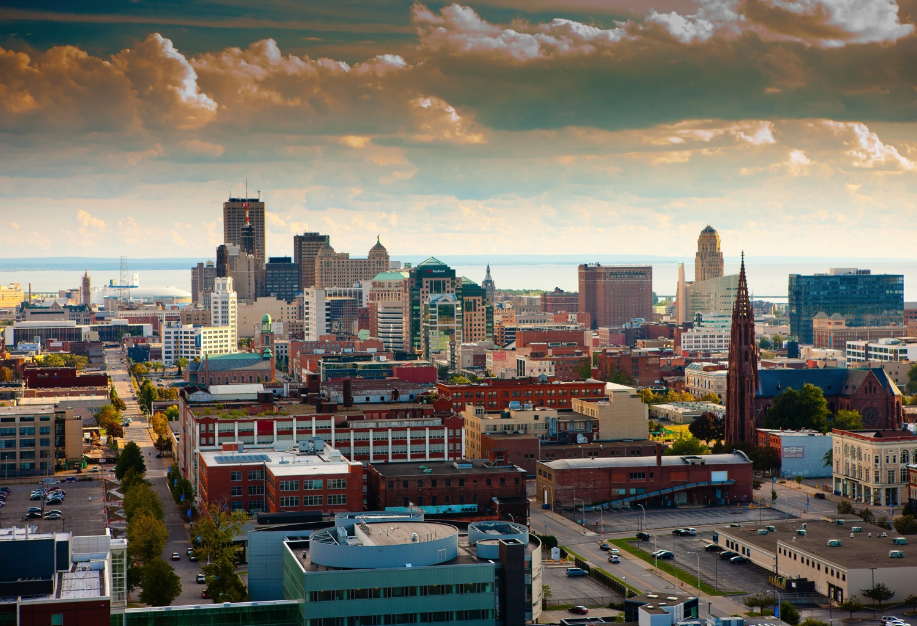
Notes:
Like universities across the nation, UB is increasingly called on to play a key role in driving economic development. This is a complex issue. On the one hand, state funding hinges on our ability to justify our relevance in terms of job creation and economic impact. But our societal obligation goes much deeper—as a public research university, we have an inherent responsibility to advance the public good. We have an ethical obligation to enrich our community-economically, socially, and culturally. Our economic impact is not just a matter of job numbers and dollars spent. And educating people for success in this economy is more than a matter of training them for specific jobs—it is about preparing students to be thoughtful leaders in a global knowledge economy.
UB recognizes that building a thriving knowledge based economy depends on ensuring equitable access to the benefits and opportunities that come with it. We are engaging with our community partners to do just that:
Opportunities Advisory Council
Working with MWBEs: Assistance with Certifications
UB is leading SUNY campus in MWBE contract participation. (26.52% in 2012—more than double that of any other SUNY research center).
As we make progress on all three campuses—North, South, and Downtown—we are partnering with our surrounding neighborhoods in Amherst, Main Street, and Downtown—to enhance the vitality of our shared communities.
Balancing investments across three campuses
Developing a comprehensive transportation systems to integrate the three campuses and move people across them
FYI: Campus improvements past 3 years:
North - $292.4 million
South - $203.6 million
Downtown - $187.2 million

Slide 13
Realizing UB 2020:
Priorities for Sustaining Our Momentum
Ten-year capital plan
Capital and operational support
(e.g. NYS Center of Excellence in Materials Informatics)
Notes:
Next steps: 2012-13 budget priorities:
As we move forward with Realizing UB 2020, we continue to engage our broader communities—including elected leadership in our region and state—to seek the long-term support we need to achieve our full potential.
The legislative agenda we presented to the WNY delegation for this session includes the critical tools we need to realize UB 2020, including capital and operational support for key research and education endeavors.
SUNY capital funding request
World-class physical campus environment is critical to advancing every element of Realizing UB2020
Need to sustain and build on momentum in building out our three campuses: North, South, and Downtown.
Requesting capital necessary to complete our full list of projects submitted to SUNY in our 10 year master plan (submitted and accepted by SUNY)
Support for the Center of Excellence in Materials Informatics: for research, capital construction, business development, and commercialization of research discoveries.
The executive budget still has to go through a lengthy legislative process; we have a long way to go before we can expect a finalized budget in April. In the meantime, we will continue our advocacy efforts toward achieving the supportive infrastructure we need to sustain and build on the momentum we’ve developed across all three campuses.

Slide 14
REALIZING UB 2020
Remarks to the Voting Faculty
February 5, 2013
Notes:
This is a very exciting time to be at UB. While there are always challenges in front of us, we need to recognize the remarkable opportunities before us as well.
One of the most significant opportunities in front of us is the opportunity for UB to take on a critical leadership role in addressing issues the national higher ed community as a whole is dealing with now.
When we create strong interdisciplinary teams across the university—as we have done—we position ourselves to take full advantage of these opportunities, and ultimately to realize our UB 2020 vision.
Your contributions and dedication are key. Thank you again for the opportunity to speak with you today, and thank you for your continued commitment to realizing our university’s vision of excellence.
And now I look forward to addressing any questions you may have.

